Slide 1

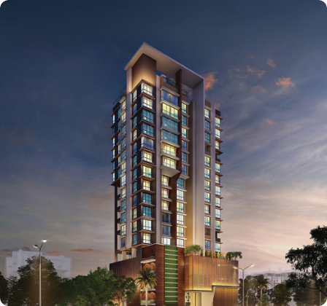




ELECTRICAL MAINTENANCE PROGRAM
Oberoi Splendor
Comprehensive Preventive Maintenance & Engineering Protocols for High-Density Infrastructure
Target Domain: Premium Residential Complex — 1,458 Housing Units & Substation Utility Grid

Slide 2






CORE PROGRAM OBJECTIVES
Life & Grid Safety
Regulatory Compliance
Energy Efficiency
Monsoon Resilience
Eliminate risk of electrocution, flashovers, and sudden thermal insulation collapse within high-tension riser ducts.
Strict alignment with CEA safety measures (2010), National Electrical Code guidelines, and statutory local rules.
Optimize Power Factor, maintain harmonics within limits, and eliminate thermal loss across line conductors.
Mitigate critical risks associated with high humidity levels and severe water ingress in basement substations.

Slide 3







MAINTENANCE FRAMEWORK
Weekly Checks
Pre-Monsoon
Quarterly Checks
Annual Overhauls
Visual diagnostic sweeps, battery pack voltage assessments, indicator lamp audits, and fuel levels check on stand-by generators.
Dewatering pump test loops, absolute roof-waterproofing evaluations, panel rubber gasket sealing, and moisture purge loops.
Sub-panel thermal scans, breaker load distribution metrics, earth resistance tests, and neutral current diagnostics.
Transformer dielectric oil breakdown tests, relay testing, busbar torque adjustments, and comprehensive grid shutdown validation.

Slide 4

EQUIPMENT & PRESCRIBED VALUES
Measuring Instrument | Target Parameter Assessed | Prescribed Values (Limits) | Reference Standard
Megger Insulation Tester | Insulation Resistance (Phase to Earth) | ≥ 1 MΩ | IS 14489 / BIS
Earth Resistance Tester | Grid Earth Pit Resistance Value | ≤ 1 Ω | IS 3043 / IEEE 80
Power Quality Analyzer | Power Factor Metrics (Efficiency) | ≥ 0.95 (Lagging) | BEE Guidelines / Tariff rules
Harmonics Analyzer | Total Harmonic Distortion (Voltage / Current) | THD ≤ 5% | IEEE 519 Standard
*All calibration records must stay updated quarterly. Measurements violating these statutory parameters warrant immediate isolations and diagnostic intervention.

Slide 5

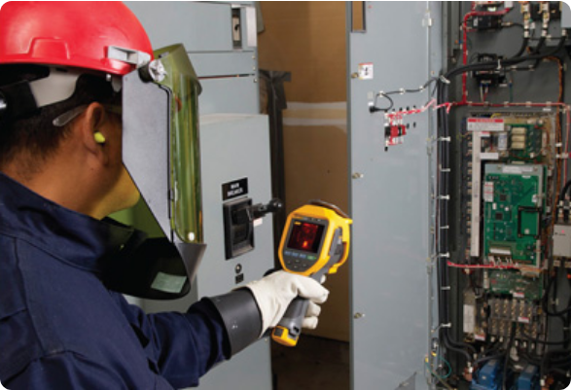
SAFETY & FIRE PREVENTION
Mandatory PPE Protocols
Strict utilization of Arc-flash suits, tested insulated rubber gloves (Class 00 to 2), and certified non-conductive safety helmets.
Dedicated Fire Suppression
Strategic deployment of clean-agent CO2 extinguishers alongside integrated gas release modules in the breaker rooms.
Smart Alarm & Evacuation
Integration of Aspirating Smoke Detection Systems (VESDA) paired with automated isolation relay control systems.

Slide 6








PROGRAM BENEFITS & CONCLUSION
Asset Protection
Operating Savings
Insurance Benefits
Resident Peace
Increases equipment life by 40%. Prevents catastrophic failure of expensive high-voltage systems.
Elimination of local distribution leakages, and penalty waivers through continuous Power Factor correction.
Unlocks discounted premiums and guarantees prompt claim processing through periodic safety inspection logs.
Assures uninterrupted lifestyle supply continuity across all 1,458 residential apartments during peak monsoon.
System Resiliency & Operational Readiness
100% RELIABILITY
Adherence to strict preventive diagnostic guidelines prevents costly grid breakdowns, fully secures resident lives, and sets an exemplary safety benchmark for modern community utilities.

